Slide 1
待更新
更新论文信息
文章 | ZOO: Zeroth Order Optimization Based Black-box Attacks to Deep Neural Networks without Training Substitute Models
Arxiv | https://arxiv.org/abs/1708.03999
发表于 | AISec '17: Proceedings of the 10th ACM Workshop on Artificial Intelligence and SecurityNovember 2017
Github | https://github.com/IBM/ZOO-Attack
总结在前：借助黑盒检索、模拟梯度、梯度下降算法，实现了对黑盒模型的攻击

Slide 2
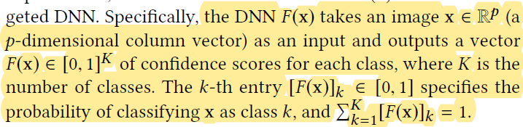
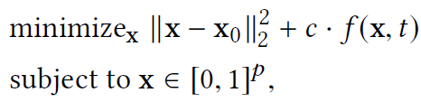


How it works
Notation for deep neural networks
接受输入，输出全部是0~1的分类概率值(如 softmax)
ZOO Attack
Optimization Problem:
f for targeted attacks:
f for untargeted attacks:
这边x的取值范围是0~1，在最小化pertuabation的同时生成一个对抗样本，而函数f(x,t)则取决于有目标的攻击还是无目标的攻击。
Zeroth order optimization on the loss function:
一阶导
二阶导

Slide 3
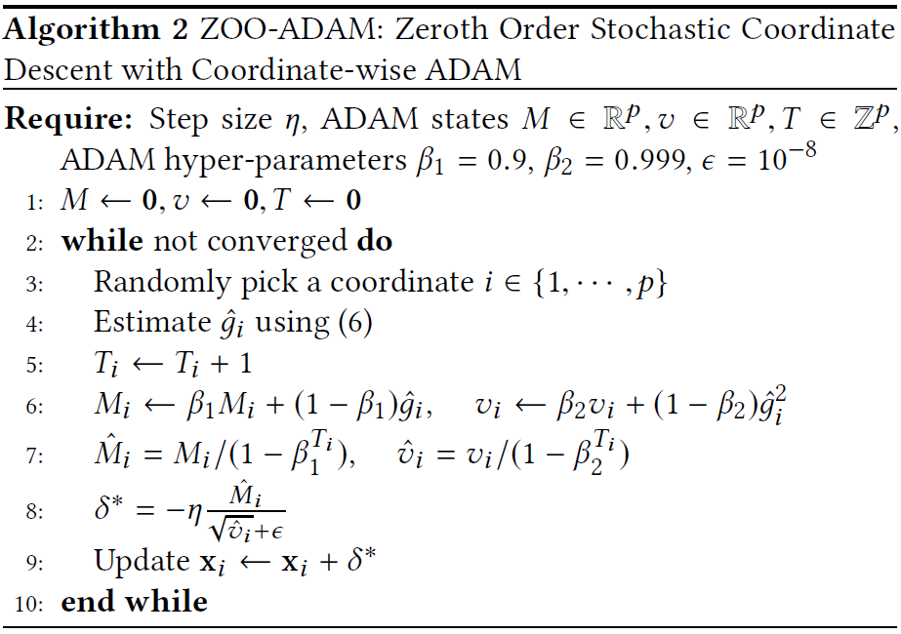
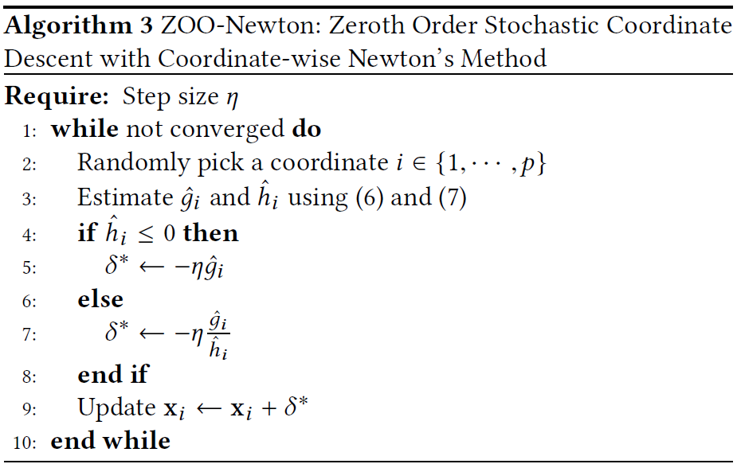
How it works
ZOO Attack - Stochastic coordinate descent
ZOO-Adam:
ZOO-Newton:
可以通过分batch检测、空间转换函数来加快训练和减小搜索空间.

Slide 4
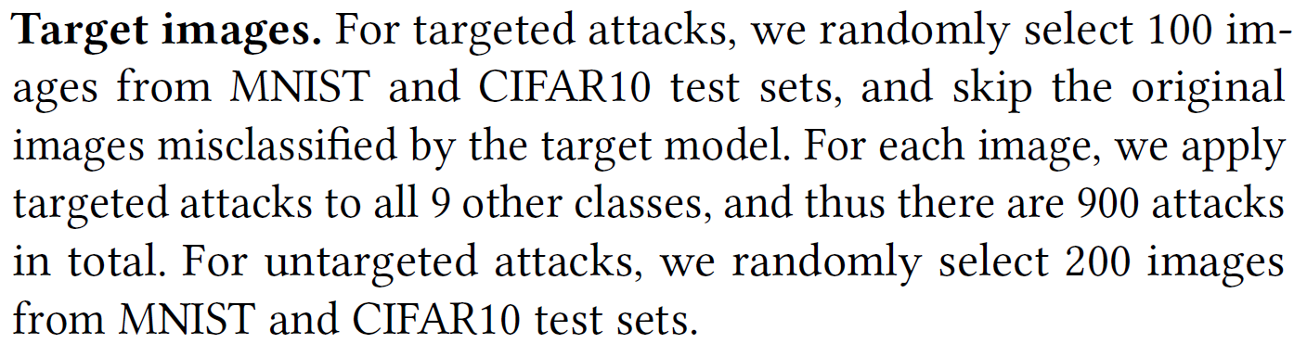
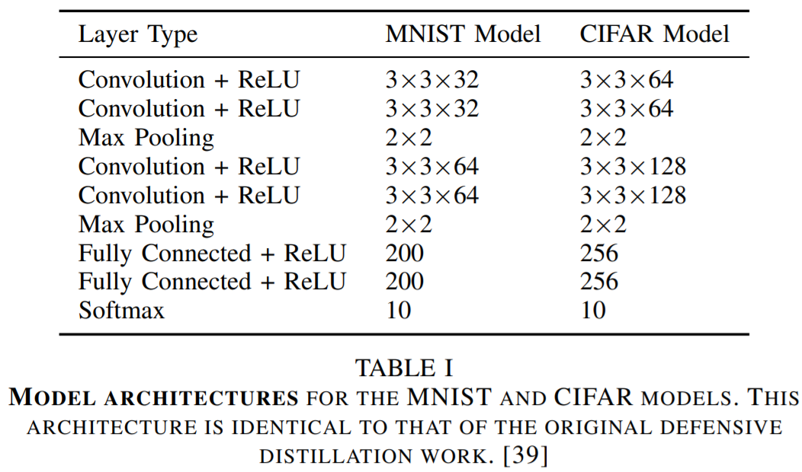
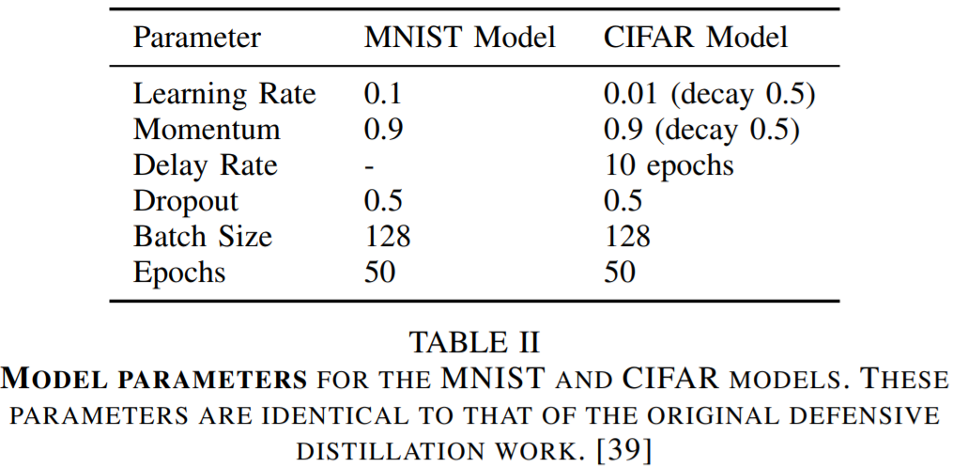
Performance Evaluation
Dataset: MNIST and CIFAR10
Model:
Target Images
在无目标攻击中，生成200个对抗样本；在有目标攻击中，生成900个对抗样本；

Slide 5
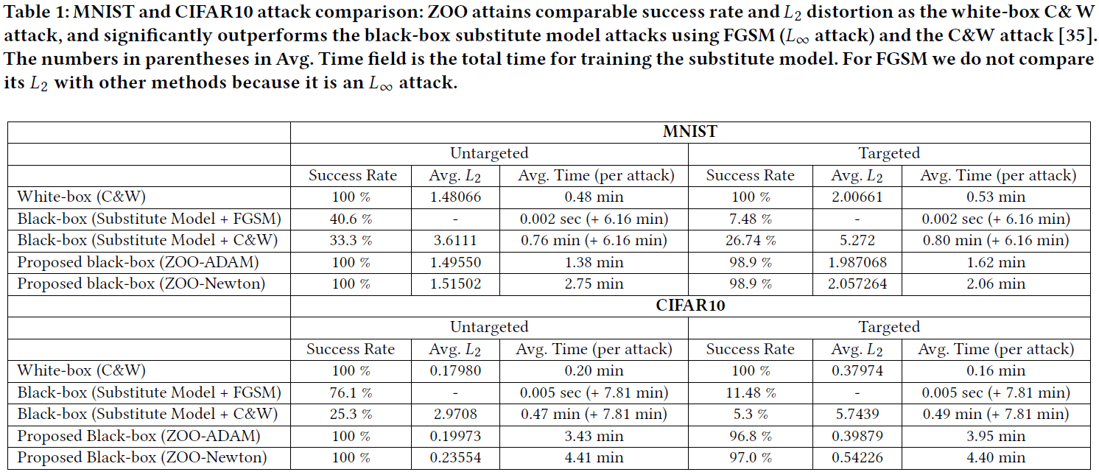
Performance Evaluation

